Slide 1
MUSHROOMS: TO EAT or NOT TO EAT
Overview of site that will help you classify mushrooms
into the Edible or Poisonous groups

Slide 2
The “Why”, “What” and “How” of this Mushroom Project
WHY: In the discussions to arrive on a topic, several ideas were vetted:
Local real estate behaviors
Healthcare ideas
Recipe collections
Plants (which factored into the final idea: mushrooms)
At this point, we realized the data types and sources were available but difficult to simplify.
In the end, we saw the underlying motivation for all of these ideas was to provide a tool to promote health & safety.

Slide 3
The “Why”, “What” and “How” of this Mushroom Project
WHAT: For naturally occurring fungi that are edible and available in any nearby green space, mushrooms varieties number over 10,000.
The practice of eating mushrooms dates back thousands of years and first documented by the Chinese.
Edibility is defined as “the absence of poisons and the presence of a desirable taste and smell”.
Health benefits of consuming mushrooms: low in sodium, fat & calories. They contain: Fiber, Potassium, Protein, Selenium (antioxidant), Copper (for cardiovascular health), Niacin (important Vitamin B), cancer-fighting ingredients (polysaccharides, linoleic acid), Zinc.
Above from: https://www.mushroom-appreciation.com/edible-mushrooms.html

Slide 4
The “Why”, “What” and “How” of this Mushroom Project
HOW: Edibility is defined as “the absence of poisons and the presence of a desirable taste and smell”.
We were able to obtain data from the Audubon Society that detailed the characteristics and clearly showed the correlation which ultimately produced the answer, i.e., is it edible or poisonous.
The primary data set contains descriptions of 173 mushroom species as entries.
Book based mushroom data set describing physical characteristics with binary classification as poisonous or edible. Two Data Set Description Files:
Primary: The primary data set encodes the textbook mushroom entries.
Secondary: The secondary data set is the pilot data which includes the results of simulations.

Slide 5
The Questions to be Answered by this Mushroom Project
QUESTION 1: If given characteristics of a mushroom, can we confidently predict whether or not that mushroom is poisonous?
QUESTION 2: What characteristics of a mushroom are best suited for this prediction?
We were able to obtain data from the Audubon Society that was very detailed listing many characteristics and clearly showed the correlation and produced an answer, i.e., is it poisonous.
The primary data set contains descriptions of 173 mushroom species as entries.

Slide 6
Data Analysis Phase of the Mushroom Project
We planned out multiple machine learning approaches (detailed in the machine learning slides) and created a correlation plot to see which data was correlated with the variable we wanted to predict.

Slide 7
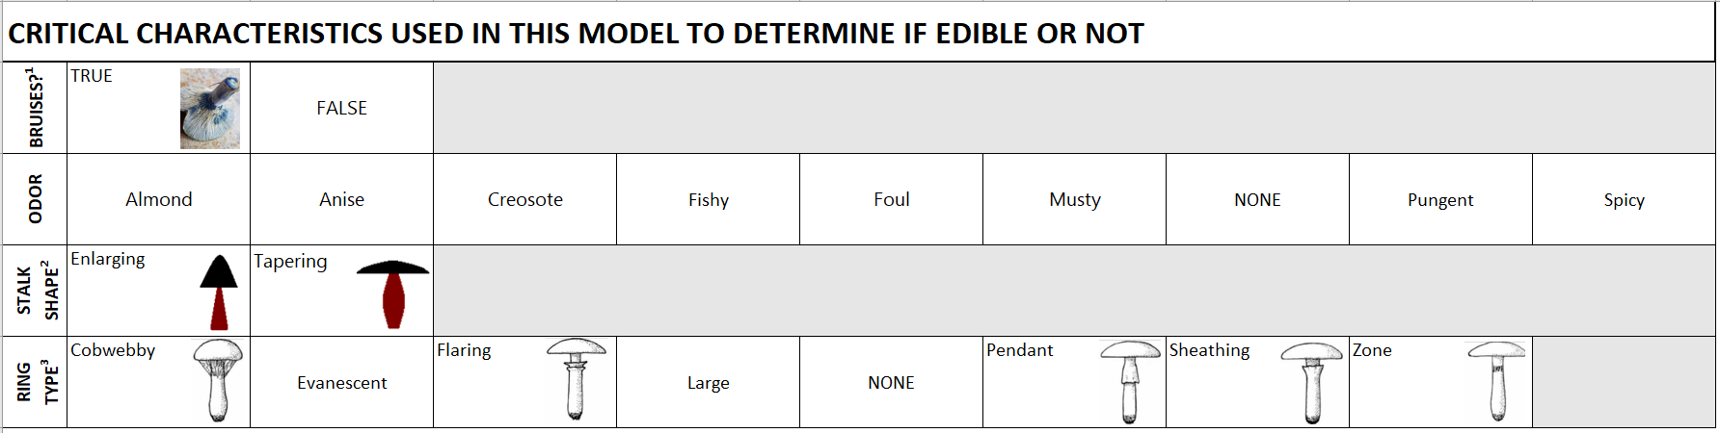
Mushroom Characteristics Included in the Model
¹ https://bit.ly/3s41u0d
² https://bit.ly/3s3Lmvq
³ https://binged.it/3KwH8TG

Slide 8
Technologies, Languages, Tools, and Algorithms used in the Mushroom Project
SQL database (local: postgres.sql)
Python (VS Code / Juypter Notebook)
Website (FLASK)

Slide 9
Machine Learning Model: A. Description of Data Pre-Processing
We eliminated all null values from the primary and secondary dataset, including the placeholder "?" representing nulls in the dataset.
We renamed the columns so that the secondary and primary datasets could be merged.
We dropped any columns that were not contained in both datasets to create a full combined dataframe.

Slide 10
B. Preliminary feature engineering & selection (including decision-making process)
In order to decide which feature to use for the input of the machine learning model, we took multiple approaches and compared the results of each output:
RandomForest
TensorFlow
Correlation Analysis
XG_Boost
After comparing the results of each, we concluded that XG_Boost was the most reliable machine learning model to use. We will ask the user to input variables that are highly correlated to whether or not a mushroom is poisonous for prediction.

Slide 11
C. How Data was Split into Training and Testing Sets
To split the data into training and testing the data we used skelearn.model_selection function train_test_split to train, test, and split the data based on whether or not the mushroom was poisonous or not.

Slide 12
D. Model Ultimately Chosen, Including Limitations and Benefits
We chose to continue using XG_Boost:
Advantages:
Regularization for avoid overfitting
In-built cross-validation capability
Cache awareness and out-of-core computing
Tree pruning using depth-first approaches

Slide 13
D. Model Ultimately Chosen, Including Limitations and Benefits (continued)
In using XG_Boost, these are disadvantages:
Disadvantages:
Sensitive to outliers
Susceptible to overfitting
Black-Box Nature is not always straightforward in explaining what is happening in the background

Slide 14
E. How the Model was Trained
OneHotEncoder was used together with train.test.split from sklearn.
No additional training will take place

Slide 15
F. Current Accuracy Score
The accuracy score is 1.0.
This is most likely due to the data being academic and created specifically for the machine learning purposes.

Slide 16
DASHBOARD

Slide 17
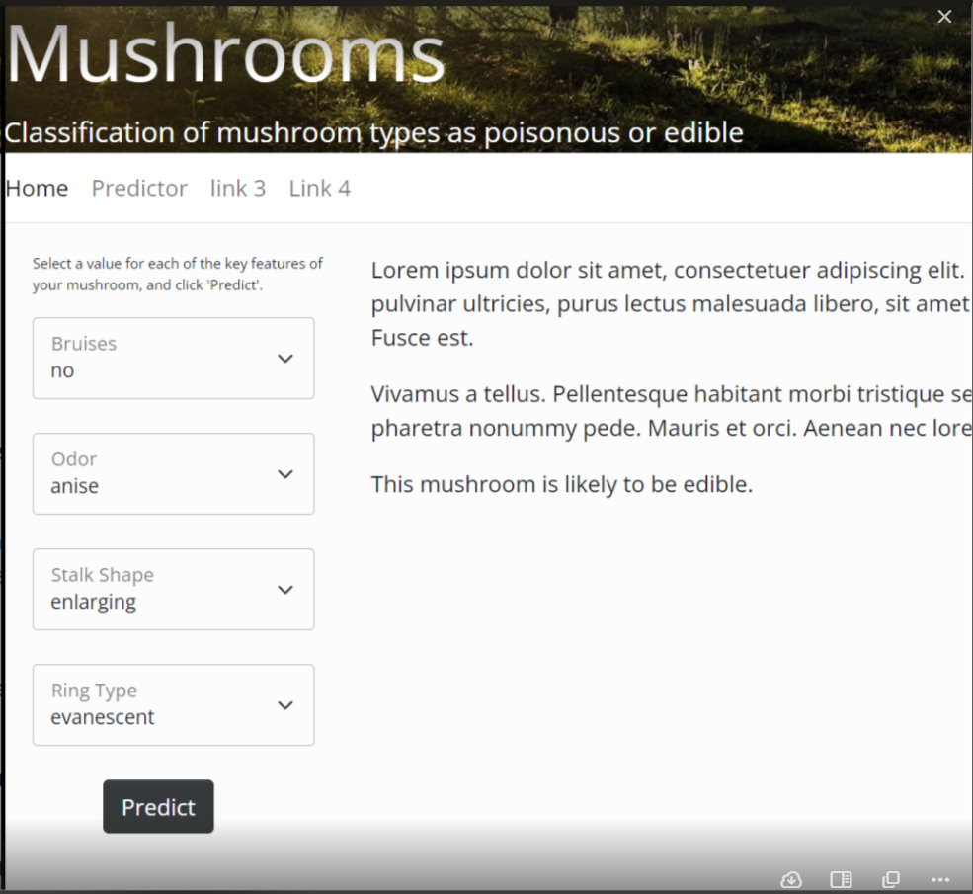
WEBSITE

Slide 18
We Hope This Helps You and Your Family
The American Association of Poison Control Centers reported that in 2019, there were 5,799 mushroom poisonings, including two deaths. Many of those cases were likely due to accidental ingestion of a mushroom that was thought to be edible.

Slide 19
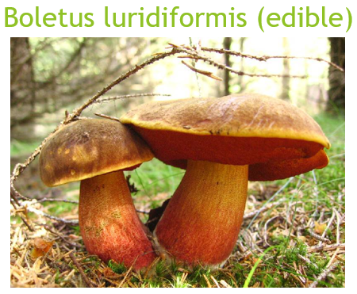
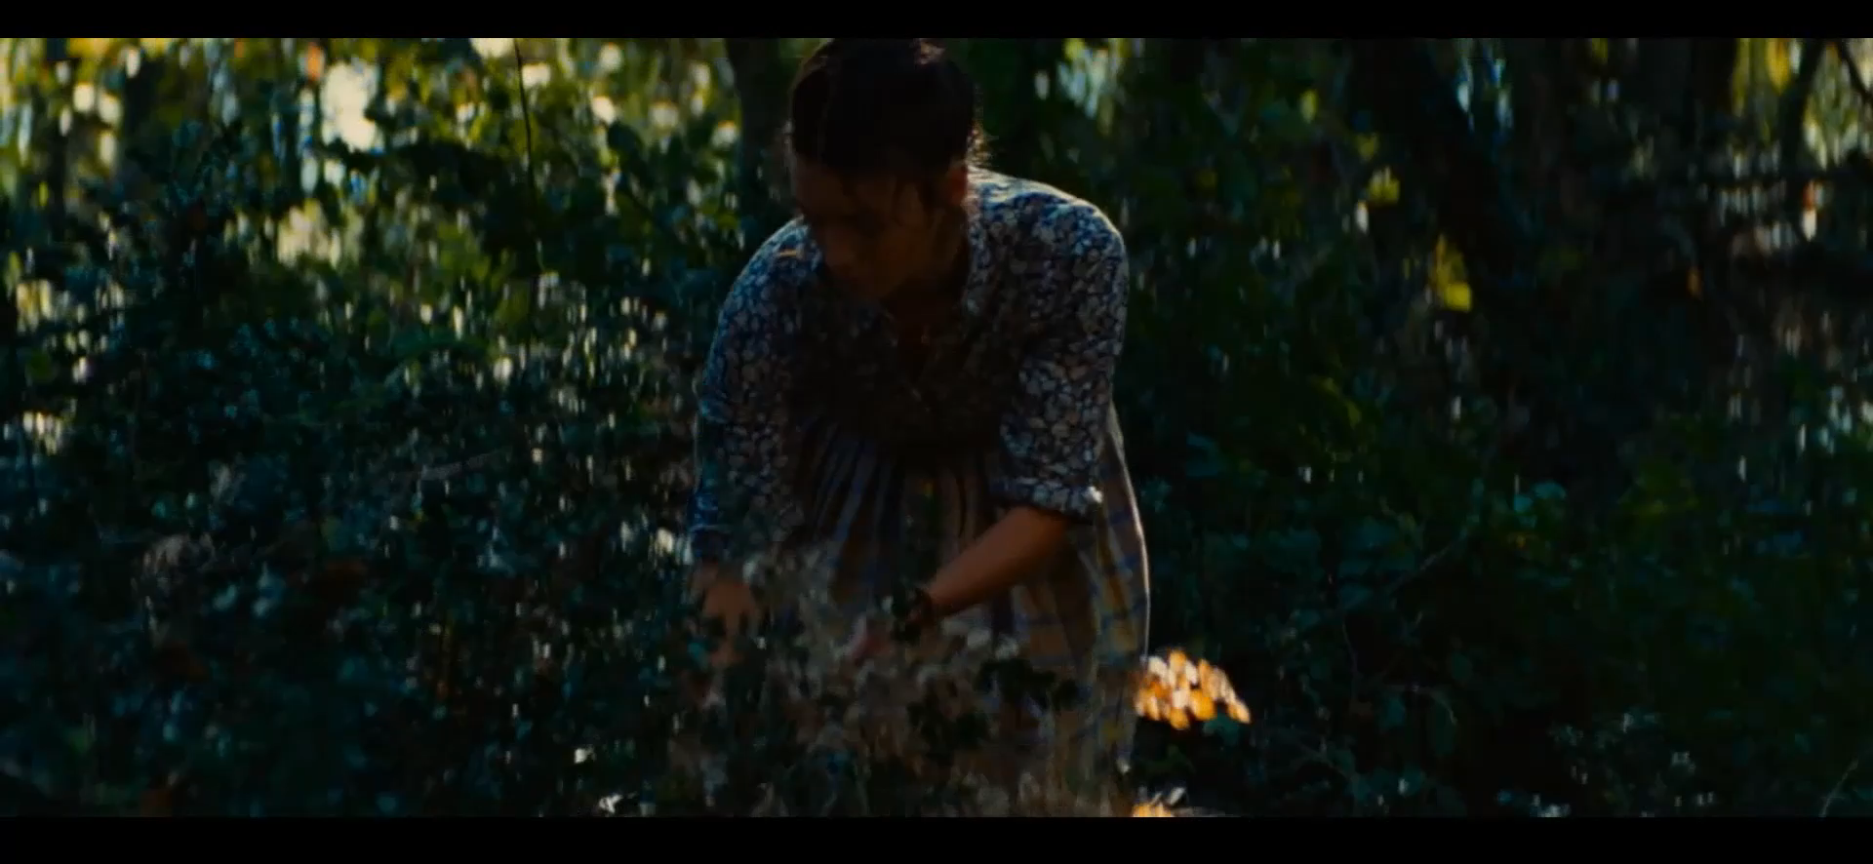
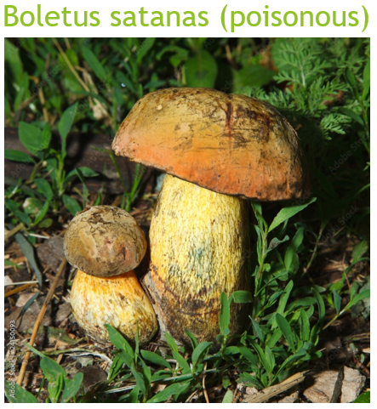
The “Why” example: look the same
From: “The Hundred-Foot Journey”

Slide 20
Edits made
Edited Slide 2 in GOOGLE SLIDES by reordering. IS OK and edited in this one too.
REPLACE SLIDE 4
INSERT FROM HERE new slide 5
INSERT LAST SLIDE: with video with captioning
INSERT SLIDE WITH: The American Association of Poison Control Centers reported that in 2019, there were 5,799 mushroom poisonings, including two deaths. Many of those cases were likely due to accidental ingestion of a mushroom that was thought to be edible.

